Slide 1
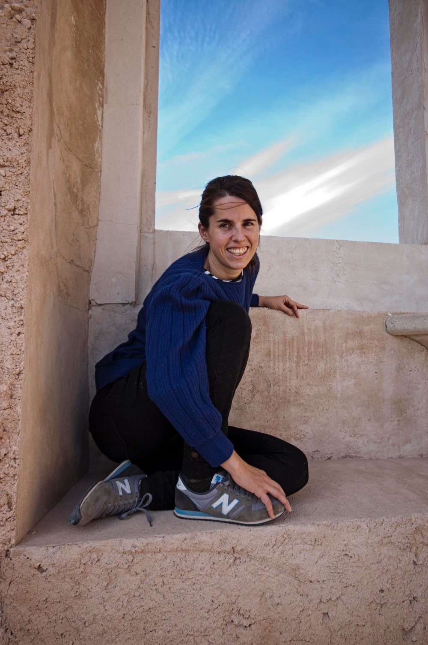
Guest lecture by Maria Gomez-Carrillo on „Discrimination in Research”
Tuesday, 8th June 2021, 10:30-11:30 Uhr via Zoom
In her research, Maria Gomez-Carrillo focuses on participatory research methodologies with persons with disabilities. She is doing two small co-researched projects in Spain, one with autistic women and one with persons with intellectual disabilities. Her research interests are access to justice, participation and equality.
Maria Gomez-Carrillo is a PhD candidate of BODYS in the DARE project. DARE – Disability Advocacy Research in Europe – is a Europe-wide training network for early career researchers in the field of disability rights, funded by the Marie Curie Program of the European Commission. Within DARE, Maria Gomez-Carillo is based at the University of Lisbon.
Registration is open until 4th June 2021. Please send an e-mail to bodys@evh-bochum.de

