Slide 1
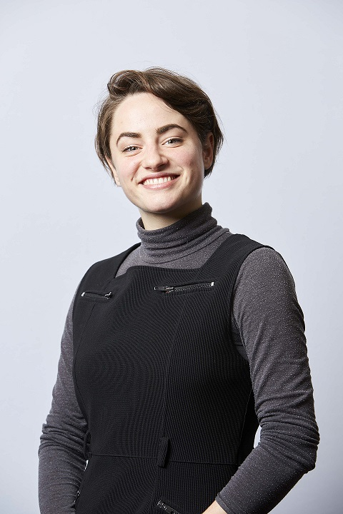
Guest lecture by Claudia Coveney on „Social movements as agents of change towards Inclusion”
Monday, 5th July 2021, 14:30-15:30 Uhr via Zoom
Claudia Coveney is looking at the ways in which disabled people’s organisations (DPOs) interact with government bodies at the European level using their collective voice. She is working with the European Disability Forum and the campaigns they have run targeting specific legislation. She wants to know which campaign strategies have led to the successful representation of that voice in resultant policy.
Claudia Coveney is a PhD candidate of BODYS in the DARE project. DARE – Disability Advocacy Research in Europe – is a Europe-wide training network for early career researchers in the field of disability rights, funded by the Marie Curie Program of the European Commission. Within DARE, Claudia Coveney is based at the University of Leeds.
Registration is open until 1st July 2021. Please send an e-mail to bodys@evh-bochum.de

